Slide 1


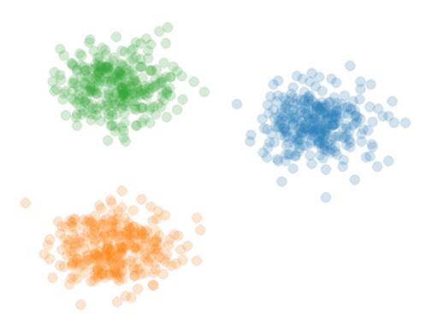
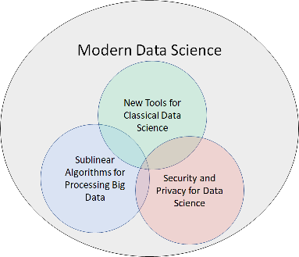

Theoretical Foundations of Modern Data Science
Samson Zhou

Slide 2



Background
Post-doc at UC Berkeley / Rice
Previous: Post-doc at Carnegie Mellon
PhD in Computer Science from Purdue
Dual Bachelors in Math, Computer Science from MIT
Research areas: Data science, sublinear algorithms, security and privacy
Notes:
I’m currently a postdoc at UC Berkeley and Rice. My research areas fall under the foundations of data science, sublinear algorithms, and security and privacy, but the central theme is introducing provable guarantees and efficient implementations for big data algorithms subject to evolving modern demands. Specifically, my goal is to have substantial real-world impact through research, teaching, and service, and so I’m looking for a platform that will enable and empower me to have such impact, which is why I’m so excited for the opportunity to apply to Rice.

Slide 3

Notes:
Enough about me, let’s talk about data science. Sources of big data are now universally present, across social media, financial markets, Internet of things, scientific data, so on and so forth, and thus understanding how to effectively and efficiently summarize the data is a crucial step toward both understanding past events as well as predicting future events.

Slide 4
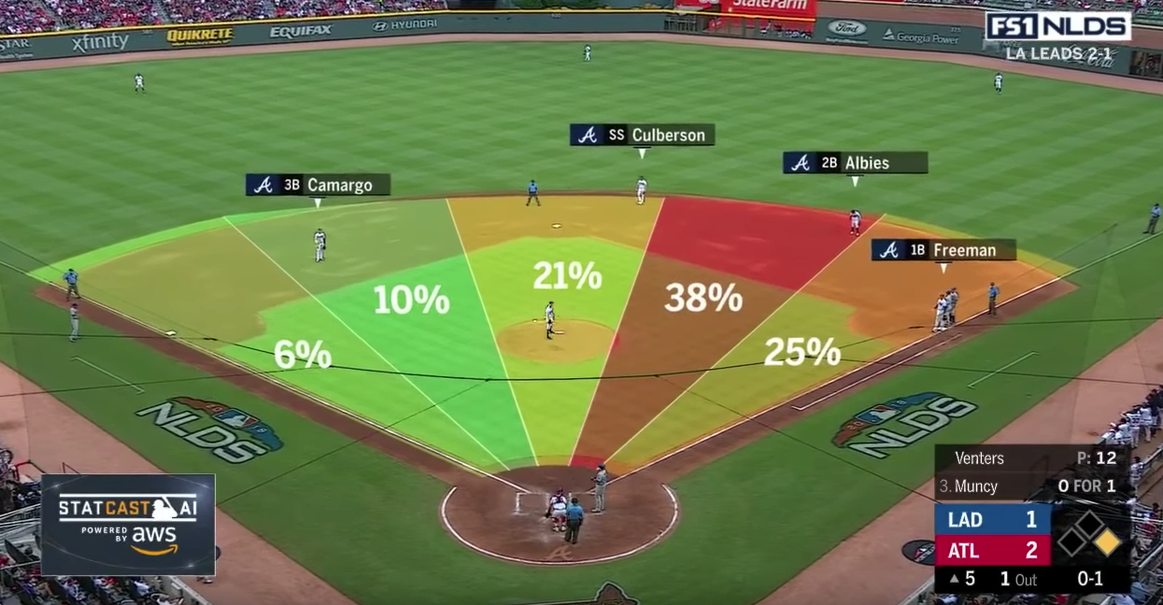

Slide 5
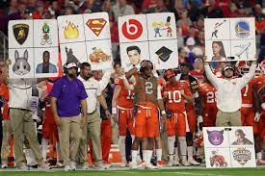

Slide 6





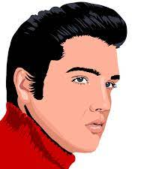


Slide 7
1 1 0 1 0 1
0

Slide 8
1 1 0 1 0 1
0 1 1 1 0 0
0
1
Notes:
Example: regression

Slide 9
1 1 0 1 0 1
0 1 1 1 0 0
0 1 0 1 1 1
0 1 1 0 1 0
1 0 1 1 1 1
0 1 1 1 0 1
0 0 1 0 1 1
0
1
1
0
0
1
0
Notes:
Example: regression

Slide 10
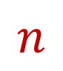
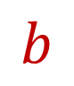


$$A$$
$$b$$
1 1 0 1 0 1
0 1 1 1 0 0
0 1 0 1 1 1
0 1 1 0 1 0
1 0 1 1 1 1
0 1 1 1 0 1
0 0 1 0 1 1
0
1
1
0
0
1
0
$$n$$
$$d$$
Notes:
Example: regression

Slide 11
$$A$$
$$b$$
1 1 0 1 0 1
0 1 1 1 0 0
0 1 0 1 1 1
0 1 1 0 1 0
1 0 1 1 1 1
0 1 1 1 0 1
0 0 1 0 1 1
0
1
1
0
0
1
0
$$n$$
$$d$$
Notes:
Example: regression

Slide 12
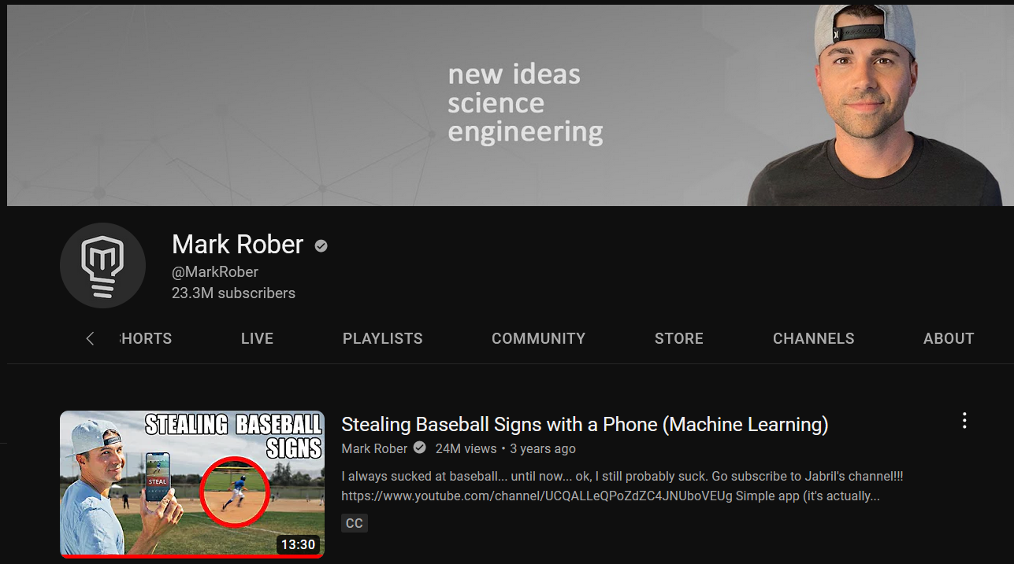
Notes:
Steal signs

Slide 13

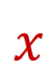
$$A$$
$$b$$
1 1 0 1 0 1
0 1 1 1 0 0
0 1 0 1 1 1
0 1 1 0 1 0
1 0 1 1 1 1
0 1 1 1 0 1
0 0 1 0 1 1
0
1
1
0
0
1
0
$$x$$
$$n$$
$$≈$$
$$d$$
Notes:
Example: regression

Slide 14
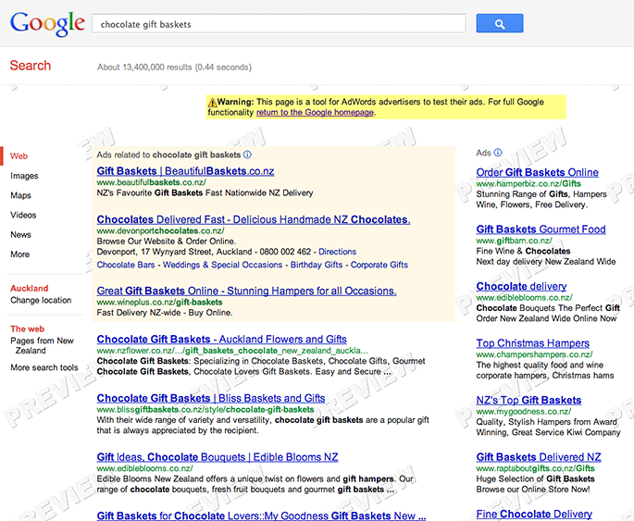

Slide 15
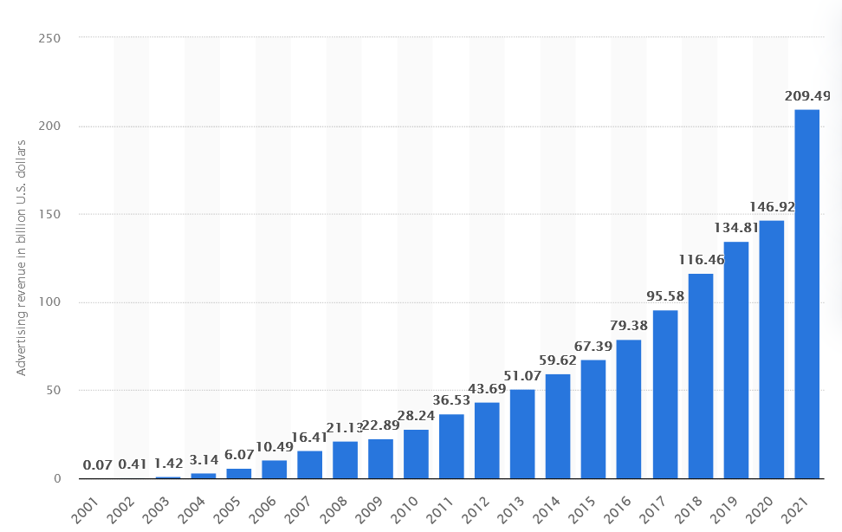

Google Ad Revenue (2001-2021, billion USD)

Slide 16
Modern Data Science
New Tools for Classical Data Science
Sublinear Algorithms for Processing Big Data
Security and Privacy for Data Science

Slide 17
Evolving Demands
Sublinear-time or sublinear-space algorithms
Incorporation of advice
Robustness to noise or adversarial input
Ability to handle time-sensitive data
Security and privacy
Notes:
However, as the field of big data algorithms matures, we have realized that often implementing an algorithm to simply perform analysis is not enough; we might also require specific properties or functionality from the algorithm, such as sublinear-time or sublinear-space, incorporation of advice, security and privacy, robustness to noise or adversarial input, or the ability to handle time-sensitive data. These are crucial qualities that I’ve integrated into my research on algorithmic design and so throughout this talk as I summarize some of my broader work in each of the Venn diagram categories, I’ll also interleave discussion of these modern demands.

Slide 18
New Tools for Classical Data Science

Slide 19
Evolving Demands
Sublinear-time or sublinear-space algorithms
Incorporation of advice
Robustness to noise or adversarial input
Ability to handle time-sensitive data
Security and privacy

Slide 20
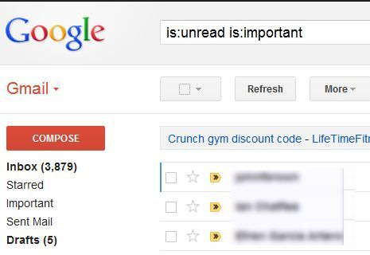

330 billion daily e-mails
3 billion monthly active users
8.5 billion daily Google searches

Slide 21
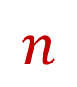

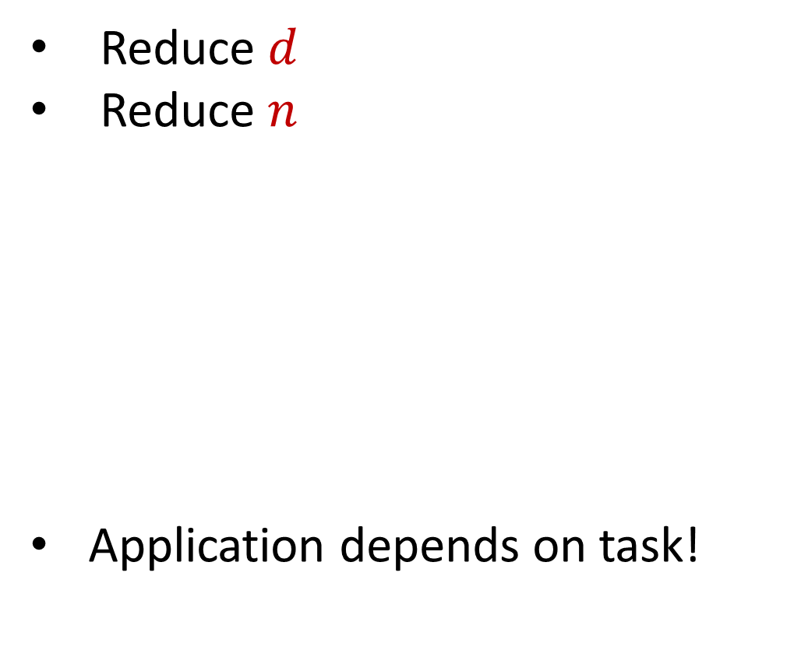

Dimensionality Reduction
Reduce $d$
Reduce $n$
Application depends on task!
Sampling, Sketching, Johnson-Lindenstrauss, IsoMap
$$n$$
$$A$$
Sampling, Sketching,
Coresets
$$d$$

Slide 22
New Dimensionality Reduction Results
Dimensionality reduction for Wasserstein barycenter [ISZ21]
Sketching for valuation functions, e.g., additive, submodular, Lipschitz [YZ19]
Kernel density estimation on kernel matrices [BKISZ22]
Notes:
Too fast

Slide 23

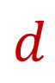
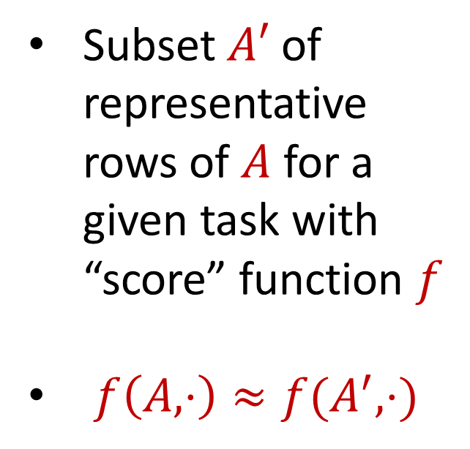
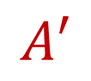
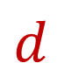
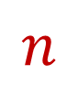
Coreset
Subset $A′$ of representative rows of $A$ for a given task with “score” function $f$
$f\left(A,⋅\right)≈f(A^{′},⋅)$
$$n$$
$$A$$
$$A′$$
$$d$$
$$d$$

Slide 24
Coreset
Lots of different constructions with various tradeoffs
Size vs. accuracy
Size vs. computation time
Size vs. interpretability
Average-case vs. worst-case performance

Slide 25
New Coreset Constructions
Coresets for data-independent neural pruning [MOBZF20]
Coresets for projective clustering [TWZBF22]
Coresets for regression on structured matrices [MMMWZF22]
Online coresets for linear algebra [BDMMUWZ20]
General coreset construction framework through sensitivity sampling [BFLSZ21]

Slide 26
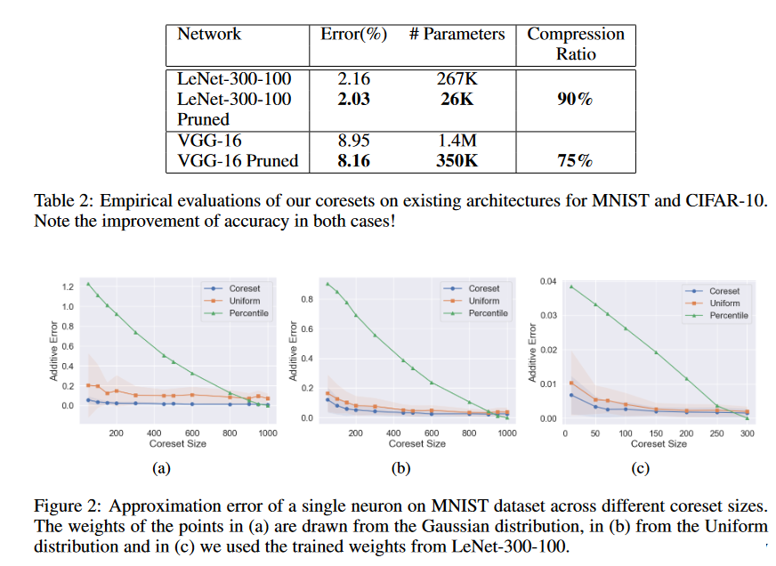
[MOBZF20]
Notes:
LeNet-300-100 is a multi-layer perceptron with two fully connected hidden layers with 300 and 100 neurons correspondingly, trained on MNIST data set. VGG-16 includes 5 blocks comprising convolutional and pooling layers, followed by 3 dense layers – the first two with 4096 neurons and the last with 1000 neurons. The model was trained and tested on CIFAR-10
Lottery ticket hypothesis

Slide 27
Evolving Demands
Sublinear-time or sublinear-space algorithms
Incorporation of advice
Security and privacy
Robustness to noise or adversarial input
Ability to handle time-sensitive data

Slide 28
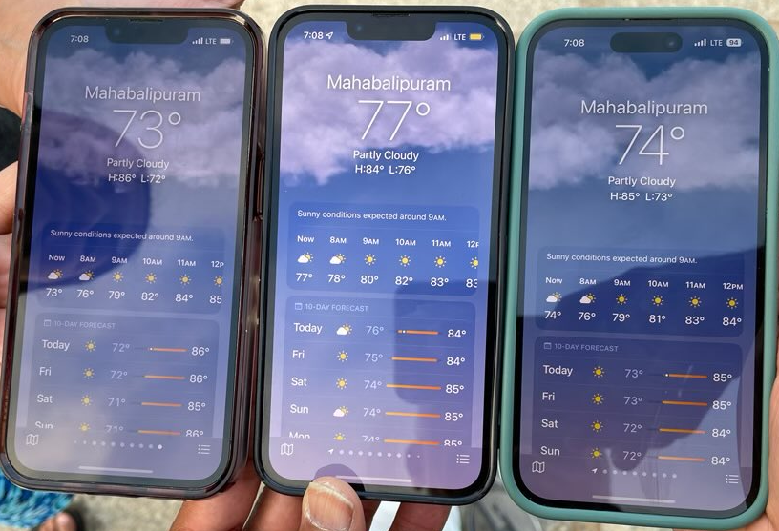

Slide 29
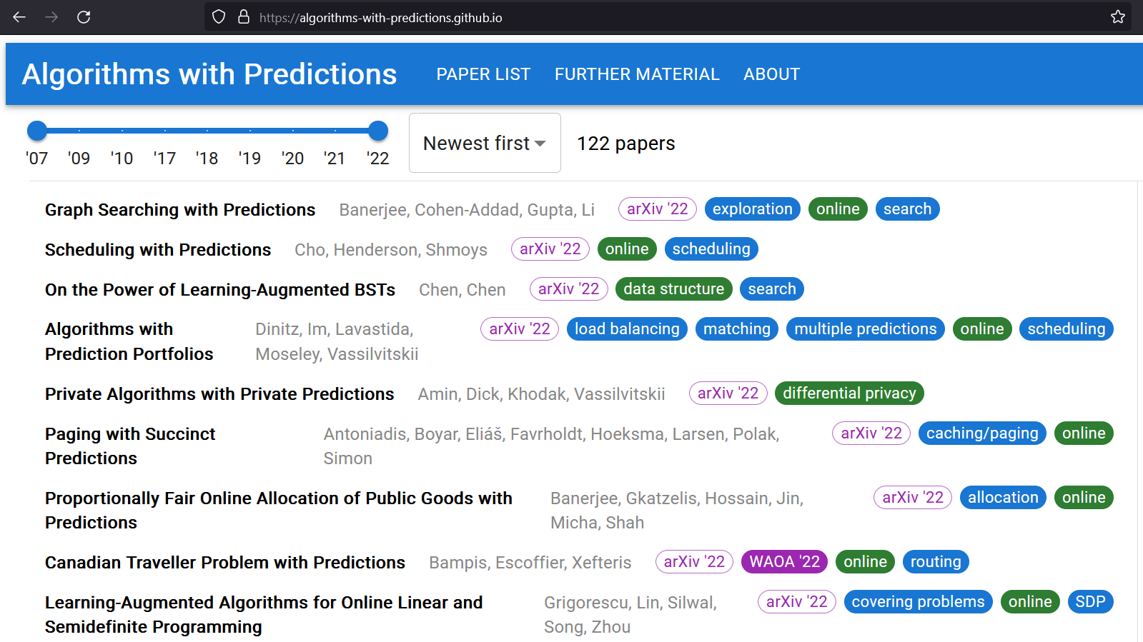

Slide 30
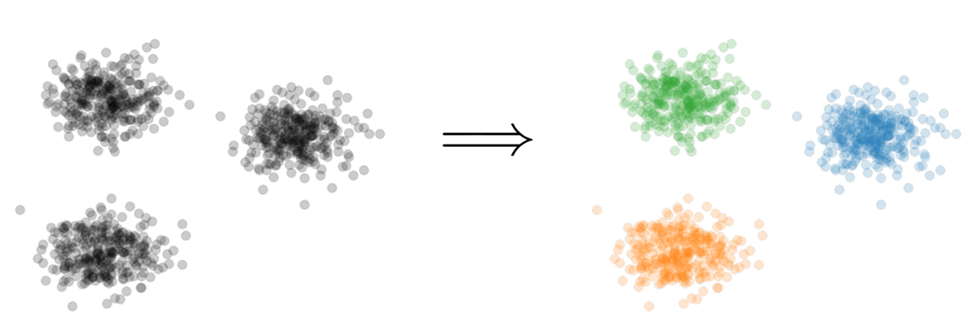

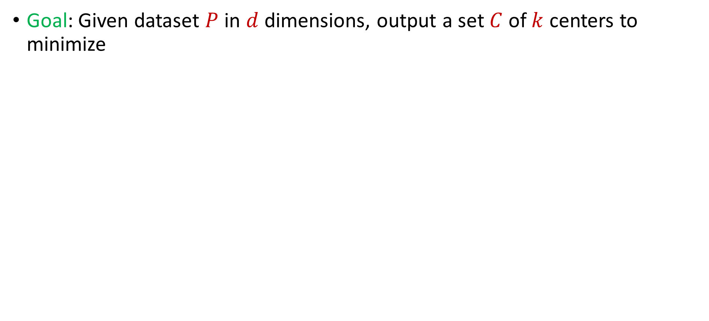
Learning-Augmented Clustering
Goal: Given dataset $P$ in $d$ dimensions, output a set $C$ of $k$ centers to minimize
$$\sum_{p∈P}{{\min_{c∈C}\left\|p−c\right\|}_{2}^{2}}$$

Slide 31
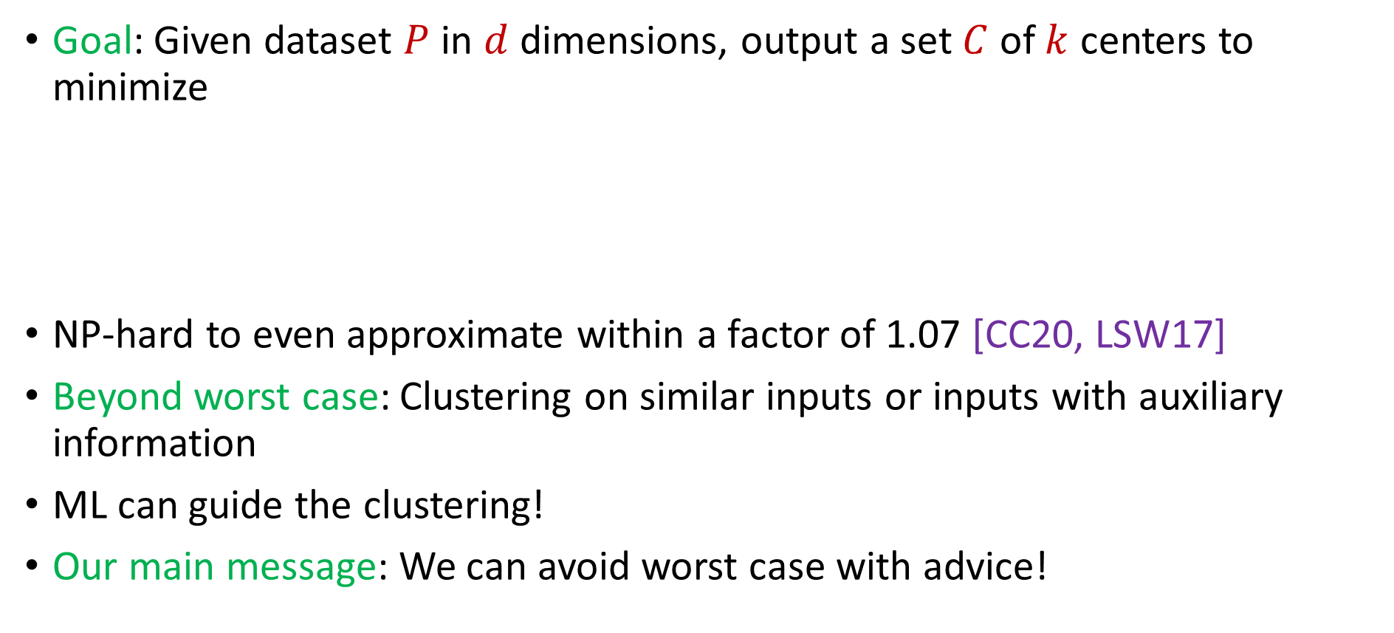
Learning-Augmented Clustering
Goal: Given dataset $P$ in $d$ dimensions, output a set $C$ of $k$ centers to minimize
NP-hard to even approximate within a factor of 1.07 [CC20, LSW17]
Beyond worst case: Clustering on similar inputs or inputs with auxiliary information
ML can guide the clustering!
Our main message: We can avoid worst case with advice!
$$\sum_{p∈P}{{\min_{c∈C}\left\|p−c\right\|}_{2}^{2}}$$
Notes:
[Cohen-AddadC.S.20], [LeeSchmidtWright17]

Slide 32


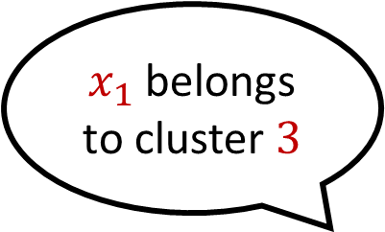
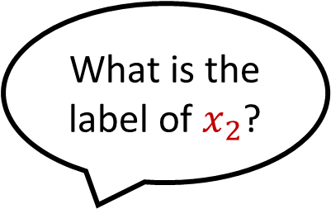

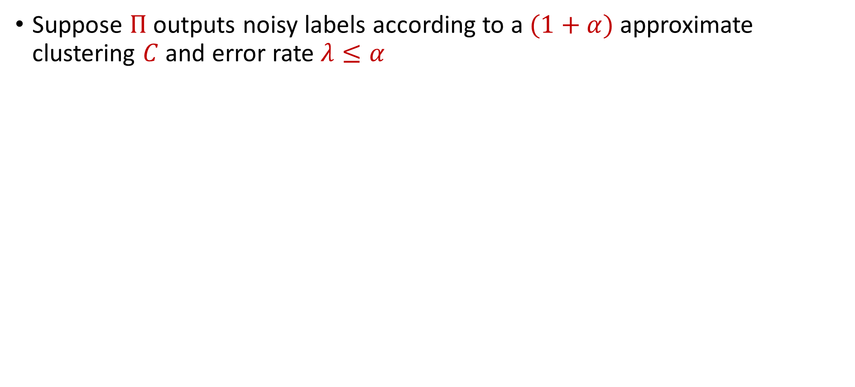
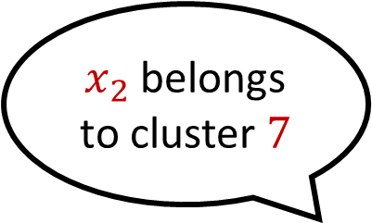
Predictor
Suppose $Π$ outputs noisy labels according to a $(1+α)$approximate clustering $C$ and error rate $λ≤α$
What is the label of $x_{1}$?
$x_{1}$ belongs to cluster $3$
What is the label of $x_{2}$?
$x_{2}$ belongs to cluster $7$

Slide 33
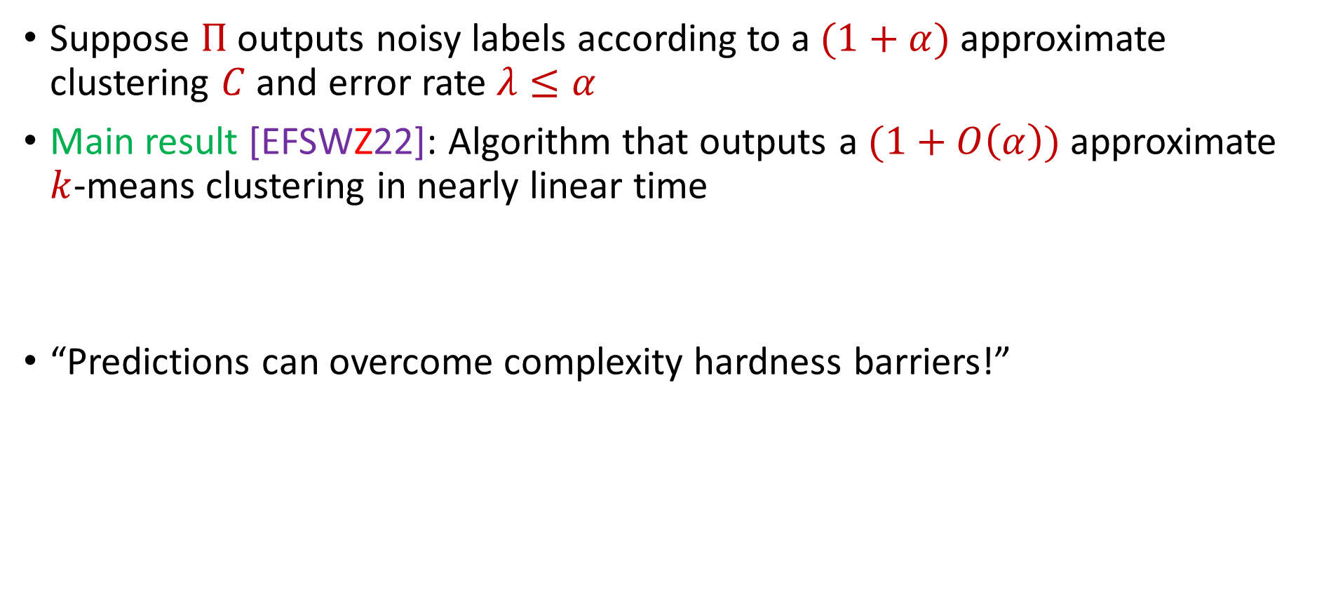
Theoretical Guarantee
Suppose $Π$ outputs noisy labels according to a $(1+α)$approximate clustering $C$ and error rate $λ≤α$
Main result [EFSWZ22]: Algorithm that outputs a $(1+O\left(α\right))$approximate $k$-means clustering in nearly linear time
“Predictions can overcome complexity hardness barriers!”

Slide 34
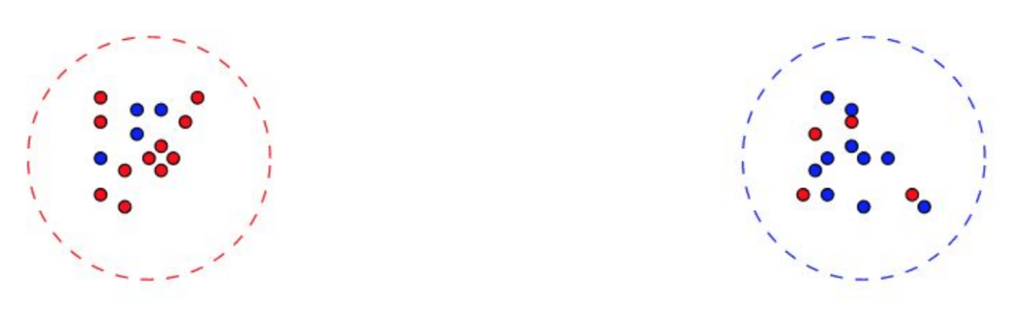
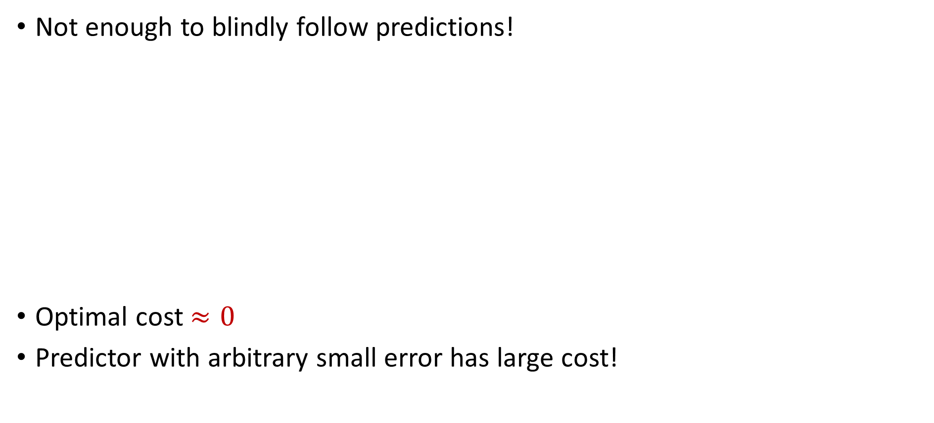
Algorithmic Intuition
Not enough to blindly follow predictions!
Optimal cost $≈0$
Predictor with arbitrary small error has large cost!

Slide 35
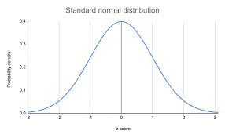
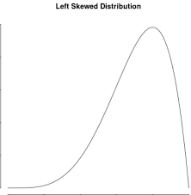


Algorithmic Intuition
Not enough to blindly follow predictions!
Our approach: Use robust mean estimation
$$\left(1−ε\right)P$$
$$εQ$$

Slide 36
Algorithmic Intuition
Not enough to blindly follow predictions!
Our approach: Use robust mean estimation
$$\left(1−ε\right)P$$
$$εQ$$

Slide 37
Algorithmic Intuition
Not enough to blindly follow predictions!
Our approach: Use robust mean estimation
$$\left(1−ε\right)P$$
$$εQ$$
Notes:
No need for interval

Slide 38
Algorithmic Intuition
Not enough to blindly follow predictions!
Our approach: Use robust mean estimation
We exploit the fact that cluster centers are means of points!

Slide 39
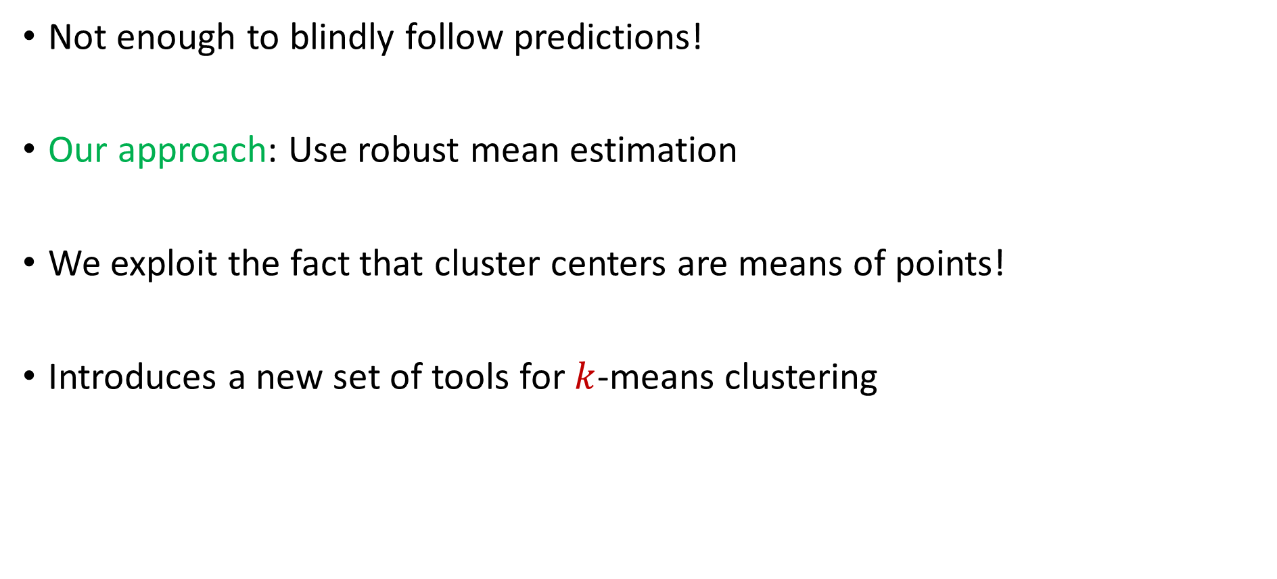
Algorithmic Intuition
Not enough to blindly follow predictions!
Our approach: Use robust mean estimation
We exploit the fact that cluster centers are means of points!
Introduces a new set of tools for $k$-means clustering

Slide 40
Experimental Results
Case Study: Spectral clustering on graphs varying over time
Dataset: Internet router graph varying over the course of a year
Methodology: Compare to standard benchmarks while using various natural predictors, i.e., noisily perturb true labels and compare to baselines as function of error
Notes:
Experiments unclear (spectral clustering)

Slide 41
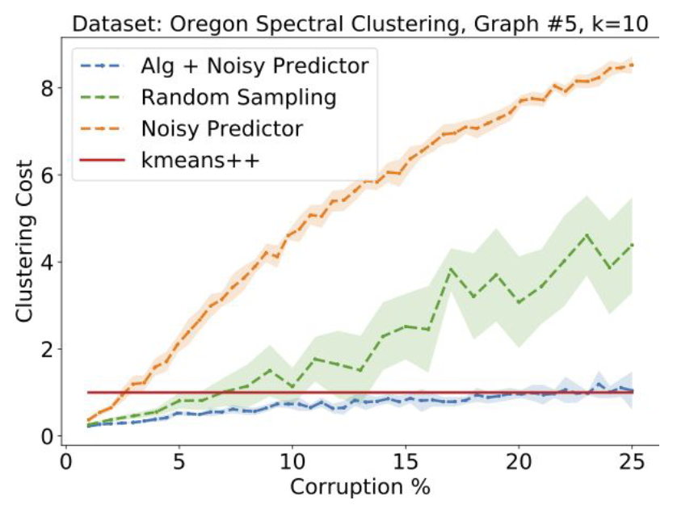
Conclusion: Our algorithm (using predictor) outperforms benchmarks such as $k$-means ++ for low error while staying competitive with high corruptions

Slide 42
My Recent Work on Data Science
Learning-Augmented k-means Clustering (ICLR 2022)
Fast Regression for Structured Inputs (ICLR 2022)
New Coresets for Projective Clustering and Applications (AISTATS 2022)
Dimensionality Reduction for Wasserstein Barycenter (NeurIPS 2021)
Learning a Latent Simplex in Input Sparsity Time (ICLR 2021)
Near Optimal Linear Algebra in the Online and Sliding Window Models (FOCS 2020)
Data-Independent Neural Pruning via Coresets (ICLR 2020)
Adversarially Robust Submodular Maximization under Knapsack Constraints (KDD 2019)

Slide 43
Questions?

Slide 44
Sublinear Algorithms for Processing Big Data

Slide 45
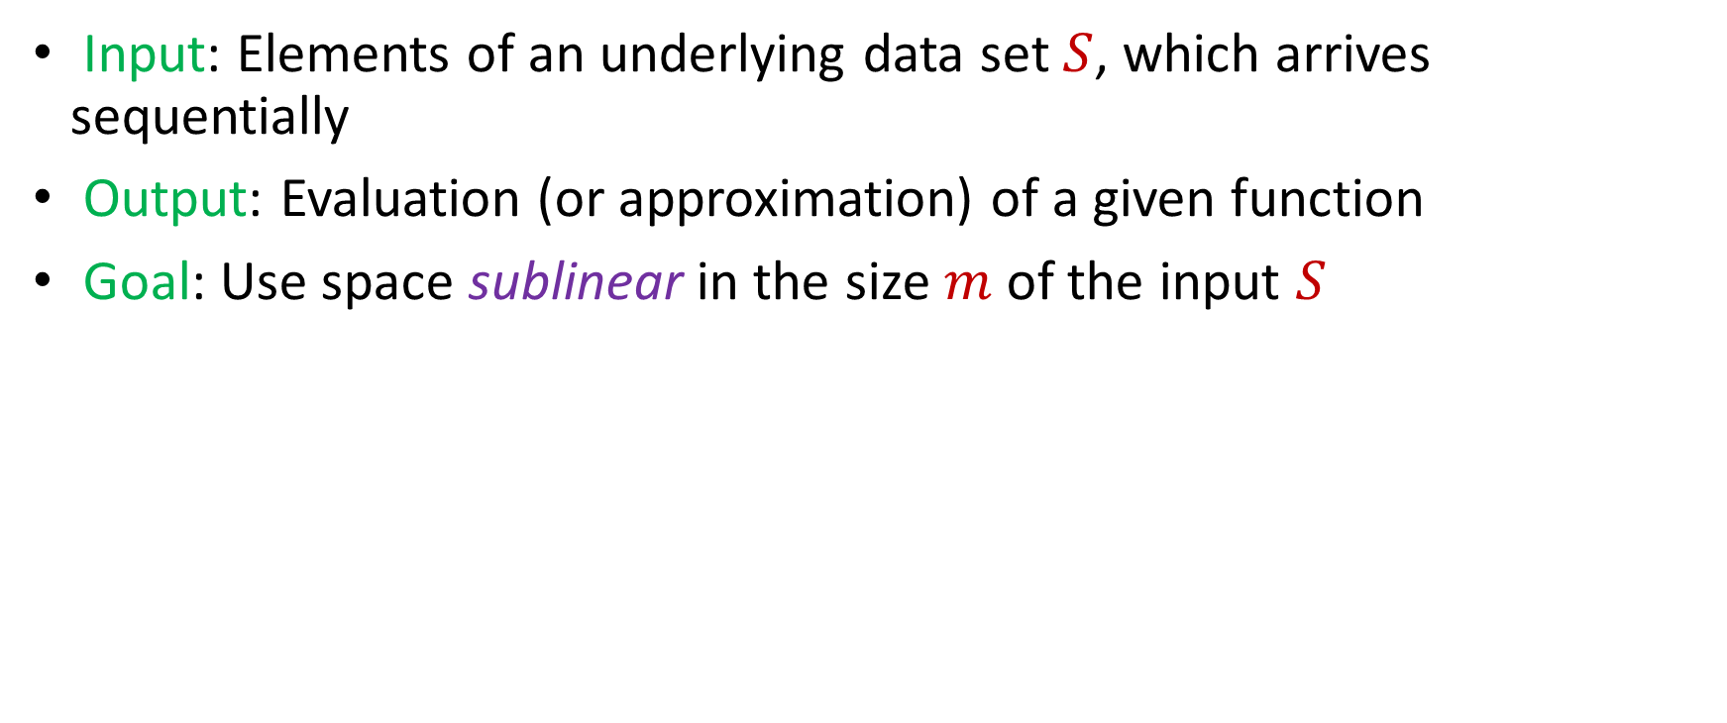
Model #1: Streaming Model
Input: Elements of an underlying data set $S$, which arrives sequentially
Output: Evaluation (or approximation) of a given function
Goal: Use space sublinear in the size $m$of the input $S$
1 0 1 1 1 0 0 1

Slide 46
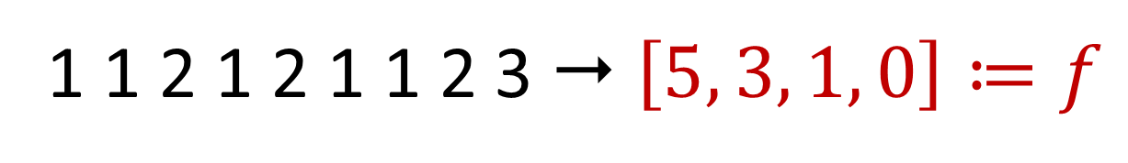
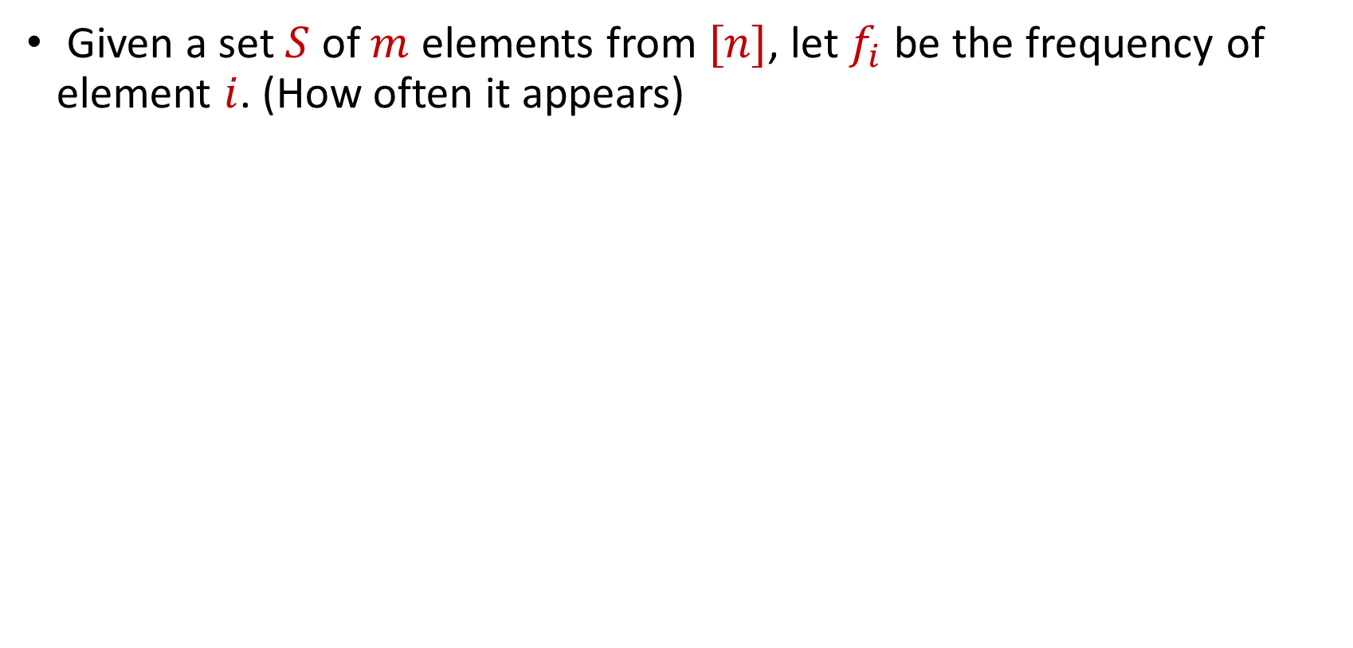
Frequency Vector
Given a set $S$ of $m$ elements from $[n]$, let $f_{i}$ be the frequency of element $i$. (How often it appears)
1 1 2 1 2 1 1 2 3  $\left[5, 3, 1, 0\right]≔f$

Slide 47
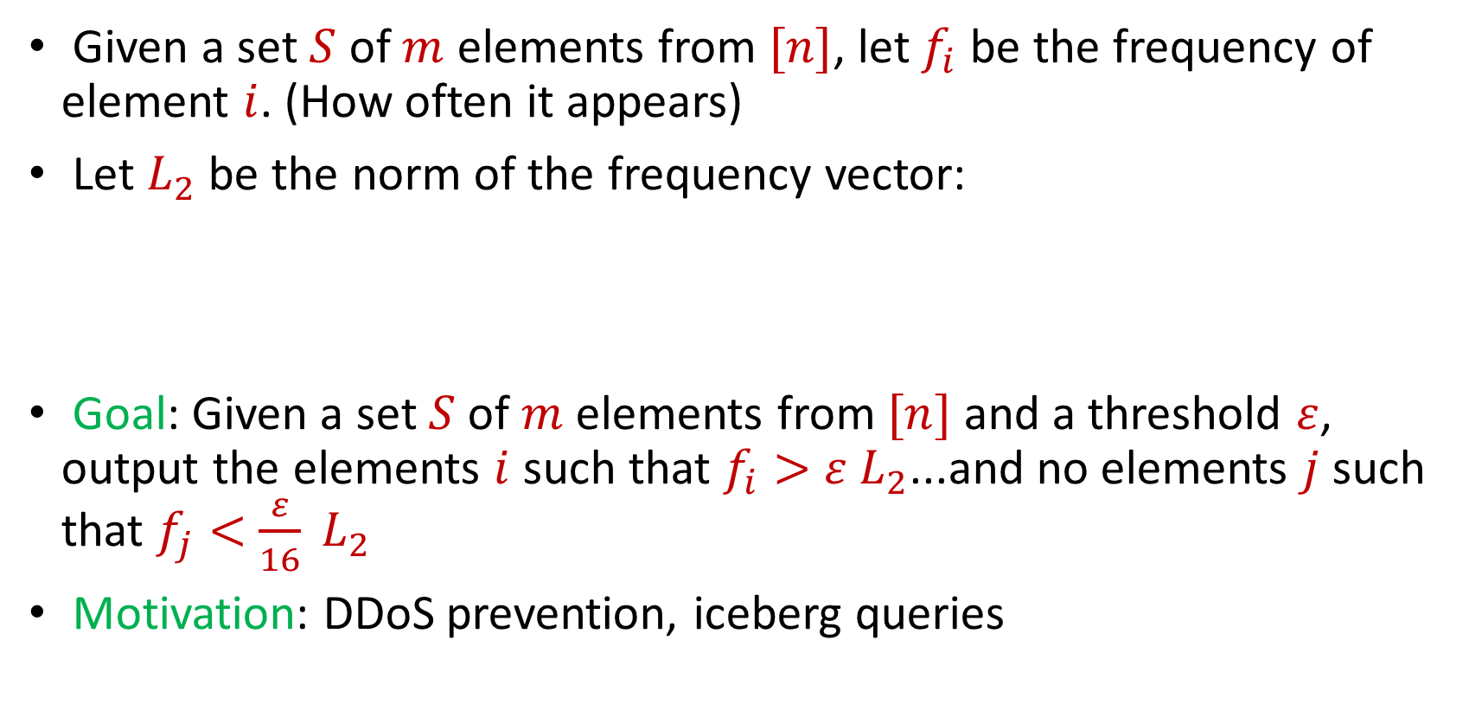
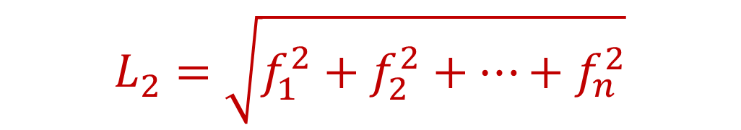
Heavy-Hitters
Given a set $S$ of $m$ elements from $[n]$, let $f_{i}$ be the frequency of element $i$. (How often it appears)
Let $L_{2}$ be the norm of the frequency vector:
Goal: Given a set $S$ of $m$ elements from $[n]$ and a threshold $ε$, output the elements $i$ such that $f_{i}>$ $ε L_{2}$...and no elements $j$ such that $f_{j}<$ $\frac{ε}{16} L_{2}$
Motivation: DDoS prevention, iceberg queries
$$L_{2}=\sqrt{f_{1}^{2}+f_{2}^{2}+…+f_{n}^{2}}$$

Slide 48
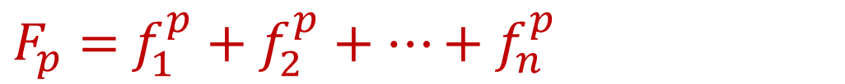
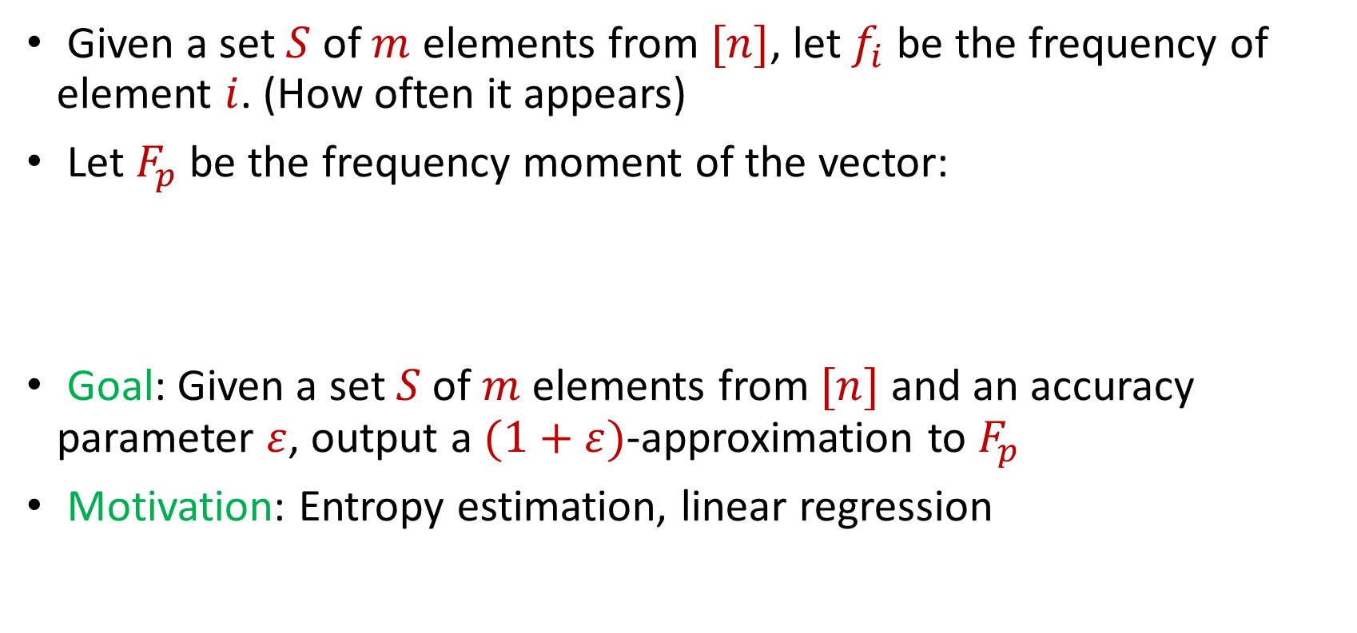
Frequency Moments
Given a set $S$ of $m$ elements from $[n]$, let $f_{i}$ be the frequency of element $i$. (How often it appears)
Let $F_{p}$ be the frequency moment of the vector:
Goal: Given a set $S$ of $m$ elements from $[n]$ and an accuracy parameter $ε$, output a $(1+ε)$-approximation to $F_{p}$
Motivation: Entropy estimation, linear regression
$F_{p}=$ $f_{1}^{p}+f_{2}^{p}+…+f_{n}^{p}$

Slide 49
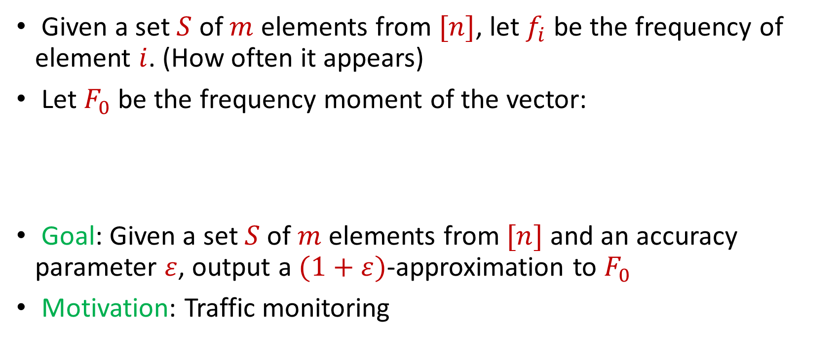
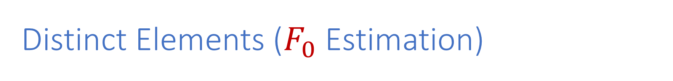
Distinct Elements ($F_{0}$ Estimation)
Given a set $S$ of $m$ elements from $[n]$, let $f_{i}$ be the frequency of element $i$. (How often it appears)
Let $F_{0}$ be the frequency moment of the vector:
Goal: Given a set $S$ of $m$ elements from $[n]$ and an accuracy parameter $ε$, output a $(1+ε)$-approximation to $F_{0}$
Motivation: Traffic monitoring
$F_{0}=$ $|\{i :f_{i}≠0\}|$

Slide 50
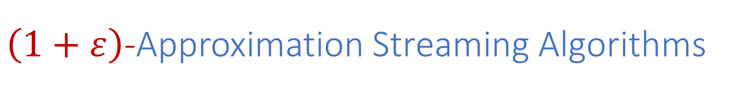
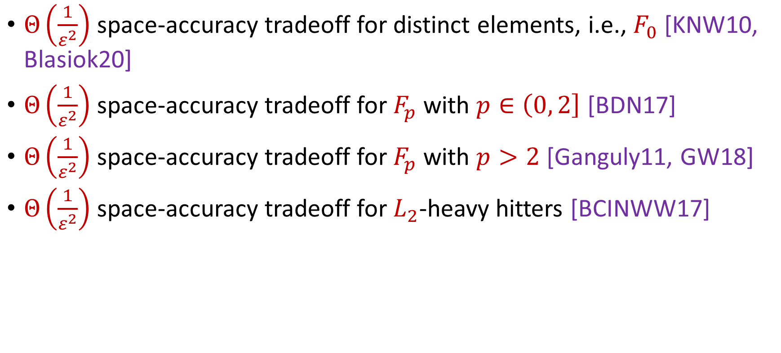
$\left(1+ε\right)$-Approximation Streaming Algorithms
$Θ\left(\frac{1}{ε^{2}}\right)$ space-accuracy tradeoff for distinct elements, i.e., $F_{0}$ [KNW10, Blasiok20]
$Θ\left(\frac{1}{ε^{2}}\right)$ space-accuracy tradeoff for $F_{p}$ with $p∈\left(0, 2\right]$ [BDN17]
$Θ\left(\frac{1}{ε^{2}}\right)$ space-accuracy tradeoff for $F_{p}$ with $p>2$ [Ganguly11, GW18]
$Θ\left(\frac{1}{ε^{2}}\right)$ space-accuracy tradeoff for $L_{2}$-heavy hitters [BCINWW17]
Notes:
[KaneNelsonWoodruff10], [Blasiok20], [BlasiokDingNelson17], [Ganguly11, GangulyWoodruff18], [BravermanChestnutIvkinNelsonWangWoodruff17]

Slide 51
Evolving Demands
Sublinear-time or sublinear-space algorithms
Incorporation of advice
Robustness to noise or adversarial input
Ability to handle time-sensitive data
Security and privacy

Slide 52
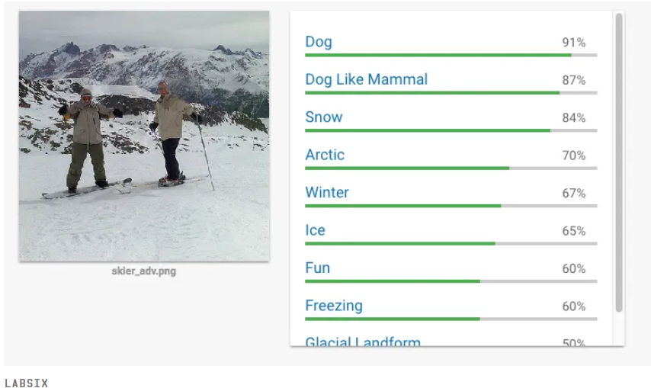
Human readers will easily identify the image as showing two men on skis. Google’s Cloud Vision service reported being 91 percent certain it saw a dog. Other stunts have shown how to make stop signs invisible, or audio that sounds benign to humans but is transcribed by software as “OK Google browse to evil dot com.”

Slide 53
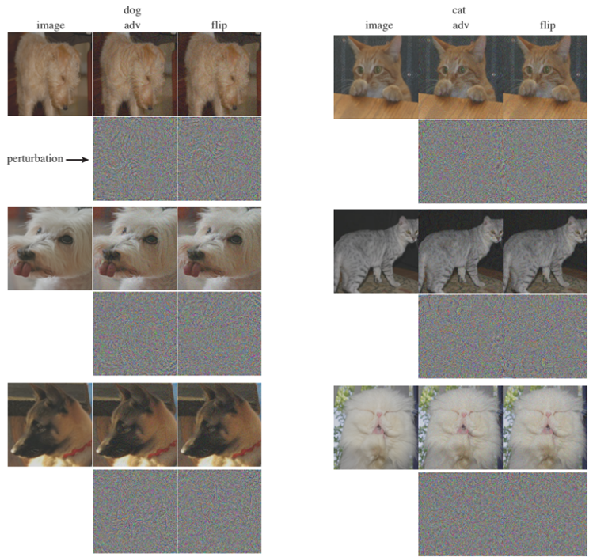

Slide 54


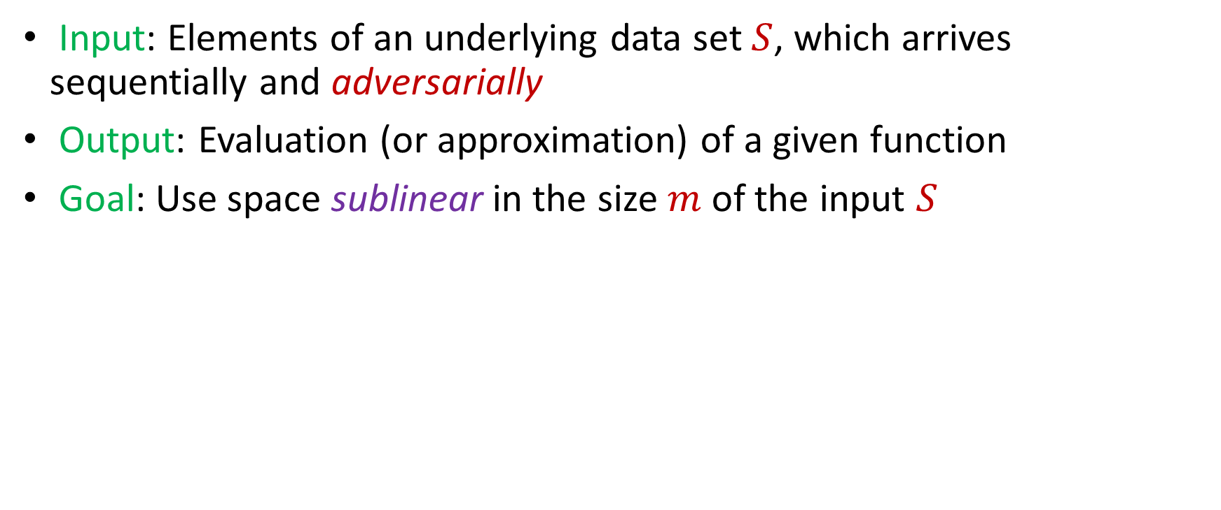
Model #2: Adversarially Robust Streaming
Input: Elements of an underlying data set $S$, which arrives sequentially and adversarially
Output: Evaluation (or approximation) of a given function
Goal: Use space sublinear in the size $m$of the input $S$
1
1
Notes:
Let’s start by breaking down each of the terms in the title. To understand the sliding window model, we first have to understand the streaming model of computation, in which elements of an underlying data set S, arrive sequentially and the goal is to evaluate or approximate some given function on this dataset, using space sublinear in S. In the sliding window model, only the W most recent updates form the underlying data set

Slide 55
Model #2: Adversarially Robust Streaming
Input: Elements of an underlying data set $S$, which arrives sequentially and adversarially
Output: Evaluation (or approximation) of a given function
Goal: Use space sublinear in the size $m$of the input $S$
10
1
Notes:
Let’s start by breaking down each of the terms in the title. To understand the sliding window model, we first have to understand the streaming model of computation, in which elements of an underlying data set S, arrive sequentially and the goal is to evaluate or approximate some given function on this dataset, using space sublinear in S. In the sliding window model, only the W most recent updates form the underlying data set

Slide 56
Model #2: Adversarially Robust Streaming
Input: Elements of an underlying data set $S$, which arrives sequentially and adversarially
Output: Evaluation (or approximation) of a given function
Goal: Use space sublinear in the size $m$of the input $S$
101
2
Notes:
Let’s start by breaking down each of the terms in the title. To understand the sliding window model, we first have to understand the streaming model of computation, in which elements of an underlying data set S, arrive sequentially and the goal is to evaluate or approximate some given function on this dataset, using space sublinear in S. In the sliding window model, only the W most recent updates form the underlying data set

Slide 57
Model #2: Adversarially Robust Streaming
Input: Elements of an underlying data set $S$, which arrives sequentially and adversarially
Output: Evaluation (or approximation) of a given function
Goal: Use space sublinear in the size $m$of the input $S$
1010
3
Notes:
Let’s start by breaking down each of the terms in the title. To understand the sliding window model, we first have to understand the streaming model of computation, in which elements of an underlying data set S, arrive sequentially and the goal is to evaluate or approximate some given function on this dataset, using space sublinear in S. In the sliding window model, only the W most recent updates form the underlying data set

Slide 58

Model #2: Adversarially Robust Streaming
Input: Elements of an underlying data set $S$, which arrives sequentially and adversarially
Output: Evaluation (or approximation) of a given function
Goal: Use space sublinear in the size $m$of the input $S$
1010
3
Notes:
Let’s start by breaking down each of the terms in the title. To understand the sliding window model, we first have to understand the streaming model of computation, in which elements of an underlying data set S, arrive sequentially and the goal is to evaluate or approximate some given function on this dataset, using space sublinear in S. In the sliding window model, only the W most recent updates form the underlying data set

Slide 59
Evolving Demands
Sublinear-time or sublinear-space algorithms
Incorporation of advice
Robustness to noise or adversarial input
Ability to handle time-sensitive data
Security and privacy
Notes:
Pictures, too many things, federated learning

Slide 60



“Facebook data policy retains user search histories for 6 months, the Apple differential privacy overview states that collected data is retained for 3 months, the Google data retention policy states that browser information may be stored for up to 9 months”

Slide 61

Model #3: Sliding Window Model
Input: Elements of an underlying data set $S$, which arrives sequentially
Output: Evaluation (or approximation) of a given function
Goal: Use space sublinear in the size $m$of the input $S$
Sliding Window: “Only the $m$ most recent updates form the underlying data set $S$”
1 0 1 1 1 0 0 1
Notes:
Let’s start by breaking down each of the terms in the title. To understand the sliding window model, we first have to understand the streaming model of computation, in which elements of an underlying data set S, arrive sequentially and the goal is to evaluate or approximate some given function on this dataset, using space sublinear in S. In the sliding window model, only the W most recent updates form the underlying data set

Slide 62
Model #3: Sliding Window Model
Input: Elements of an underlying data set $S$, which arrives sequentially
Output: Evaluation (or approximation) of a given function
Goal: Use space sublinear in the size $m$of the input $S$
Sliding Window: “Only the $m$ most recent updates form the underlying data set $S$”
1 0 1 1 1 0 0 1 1

Slide 63
Model #3: Sliding Window Model
Input: Elements of an underlying data set $S$, which arrives sequentially
Output: Evaluation (or approximation) of a given function
Goal: Use space sublinear in the size $m$of the input $S$
Sliding Window: “Only the $m$ most recent updates form the underlying data set $S$”
1 0 1 1 1 0 0 1 1 0

Slide 64

Model #3: Sliding Window Model
Input: Elements of an underlying data set $S$, which arrives sequentially
Output: Evaluation (or approximation) of a given function
Goal: Use space sublinear in the size $m$of the input $S$
Sliding Window: “Only the $m$ most recent updates form the underlying data set $S$”
Emphasizes recent interactions, appropriate for time sensitive settings
1 0 1 1 1 0 0 1 1 0 1
Notes:
The sliding window model emphasizes recent data and thus is appropriate for settings that are time sensitive.

Slide 65


$\left(1+ε\right)$-Robust Algorithms [WZ21]
$\tilde{Θ}\left(\frac{1}{ε^{2}}\right)$ space-accuracy tradeoff for $F_{0}$
$\tilde{Θ}\left(\frac{1}{ε^{2}}\right)$ space-accuracy tradeoff for $F_{p}$ with $p∈\left(0, 2\right]$
$\tilde{Θ}\left(\frac{1}{ε^{2}}\right)$ space-accuracy tradeoff for $F_{p}$ with integer $p>2$
$\tilde{Θ}\left(\frac{1}{ε^{2}}\right)$ space-accuracy tradeoff for $L_{2}$-heavy hitters
“No losses* are necessary!”
Notes:
[KaneNelsonWoodruff10], [Blasiok20], [BlasiokDingNelson17], [Ganguly11, GangulyWoodruff18], [BravermanChestnutIvkinNelsonWangWoodruff17]

Slide 66


$\left(1+ε\right)$-Robust Algorithms Summary [WZ21]
Notes:
Hard to understand

Slide 67



$\left(1+ε\right)$-Approximation Sliding Window Algorithms [WZ21]
Space $\tilde{Θ}\left(\frac{1}{ε^{2}}\right)$ algorithm for $F_{p}$ with $p∈\left(0, 2\right]$ [WZ21]
“No losses* are necessary!”

Slide 68


Slide 69

Robust Algorithms
Start many instances of the streaming algorithm at the beginning
Use an instance of the algorithm but “freeze” the output
Each time the next instance has value $(1+O\left(ε\right))$ more than the “frozen” output, use the next instance and “freeze” its output
1
Example: Number of ones in the stream (2-approximation)
1
1
1
1

Slide 70
Robust Algorithms
Start many instances of the streaming algorithm at the beginning
Use an instance of the algorithm but “freeze” the output
Each time the next instance has value $(1+O\left(ε\right))$ more than the “frozen” output, use the next instance and “freeze” its output
1 0
Example: Number of ones in the stream (2-approximation)
1
1
1
1

Slide 71
Robust Algorithms
Start many instances of the streaming algorithm at the beginning
Use an instance of the algorithm but “freeze” the output
Each time the next instance has value $(1+O\left(ε\right))$ more than the “frozen” output, use the next instance and “freeze” its output
1 0 1
Example: Number of ones in the stream (2-approximation)
1
2
2
2

Slide 72
Robust Algorithms
Start many instances of the streaming algorithm at the beginning
Use an instance of the algorithm but “freeze” the output
Each time the next instance has value $(1+O\left(ε\right))$ more than the “frozen” output, use the next instance and “freeze” its output
1 0 1
Example: Number of ones in the stream (2-approximation)
1
2
2
2

Slide 73

Robust Algorithms
Start many instances of the streaming algorithm at the beginning
Use an instance of the algorithm but “freeze” the output
Each time the next instance has value $(1+O\left(ε\right))$ more than the “frozen” output, use the next instance and “freeze” its output
1 0 1 1
Example: Number of ones in the stream (2-approximation)
1
2
3
3

Slide 74
Robust Algorithms
Start many instances of the streaming algorithm at the beginning
Use an instance of the algorithm but “freeze” the output
Each time the next instance has value $(1+O\left(ε\right))$ more than the “frozen” output, use the next instance and “freeze” its output
1 0 1 1 1
Example: Number of ones in the stream (2-approximation)
1
2
4
4

Slide 75
Robust Algorithms
Start many instances of the streaming algorithm at the beginning
Use an instance of the algorithm but “freeze” the output
Each time the next instance has value $(1+O\left(ε\right))$ more than the “frozen” output, use the next instance and “freeze” its output
1 0 1 1 1
Example: Number of ones in the stream (2-approximation)
1
2
4
4

Slide 76
Robust Algorithms
Start many instances of the streaming algorithm at the beginning
Use an instance of the algorithm but “freeze” the output
Each time the next instance has value $(1+O\left(ε\right))$ more than the “frozen” output, use the next instance and “freeze” its output
1 0 1 1 1 0 0 1 1 0 1
Example: Number of ones in the stream (2-approximation)
Number of ones stream is at least 4 and at most 8
4 is a good approximation
1
2
4
7

Slide 77

Intuition
Sketch switching for robust algorithms uses $\frac{1}{ε^{2}}$ space each time $F_{p}$ increases by $(1+ε)$ and function increases $\frac{1}{ε}$ times
1 0 1 1 1 0 0 1 1 0 1
1
2
4
7

Slide 78







Intuition
Do we really need to pay $\frac{1}{ε^{2}}$ space each time $F_{p}$ increases by $(1+ε)$?
Only need constant factor approximation to $εF_{p}(u)$
Only need constant factor approximation to $F_{p}\left(u+v\right)−F_{p}\left(u\right)$
$F_{p}(u)$
$$u$$
$$u+v$$
$F_{p}\left(u+v\right)−F_{p}\left(u\right)=εF_{p}(u)$
$F_{p}(u+v)$
$$v$$

Slide 79







Sketch Stitching
Suppose we want $F_{p}\left(u+v\right)$
$F_{p}\left(u+v\right)={(F}_{p}\left(u+v\right)−F_{p}\left(u\right))+F_{p}(u)$
$F_{p}(u+v)$
$F_{p}(u)$
$$F_{p}\left(u+v\right)−F_{p}\left(u\right)$$
$$u$$
$$v$$
$$u+v$$

Slide 80





Sketch Stitching
Suppose we want $F_{p}\left(u+v\right)$ and $v=v_{1}+v_{2}+…+v_{b}$
$F_{p}(u+v)$
$F_{p}(u)$
$$F_{p}\left(u+v\right)−F_{p}\left(u\right)$$
$$u$$
$$v_{1}$$
$$v_{2}$$
$$v$$
$$u+v$$

Slide 81

Sketch Stitching
Suppose we want $F_{p}\left(u+v\right)$ and $v=v_{1}+v_{2}+…+v_{b}$
$F_{p}\left(u+v\right)={(F}_{p}\left(u+v\right)−F_{p}\left(u\right))+F_{p}(u)$
$F_{p}(u+v)$
$F_{p}(u)$
$$F_{p}\left(u+v\right)−F_{p}\left(u\right)$$
$$u$$
$$v_{1}$$
$$v_{2}$$
$$v$$
$$u+v$$

Slide 82

Sketch Stitching
Suppose we want $F_{p}\left(u+v\right)$ and $v=v_{1}+v_{2}+…{+v}_{b}$
$F_{p}\left(u+v\right)={(F}_{p}\left(u+v\right)−F_{p}\left(u\right))+F_{p}(u)$
$F_{p} \left(u+v\right)= \left(F_{p}\left(u+v_{1}+…+v_{b}\right)−F_{p}\left(u+v_{1}+…+v_{b−1}\right)\right)+\left(F_{p}\left(u+v_{1}+…+v_{b−1}\right)−F_{p}\left(u+v_{1}+…+v_{b−2}\right)\right)+…+\left(F_{p}\left(u+v_{1}\right)−F_{p}\left(u\right)\right)$ $+ F_{p}(u)$

Slide 83

Granularity Change
Set each difference to be exponentially decreasing
$F_{p} \left(u+v\right)= \left(F_{p}\left(u+v_{1}+…+v_{b}\right)−F_{p}\left(u+v_{1}+…+v_{b−1}\right)\right)+\left(F_{p}\left(u+v_{1}+…+v_{b−1}\right)−F_{p}\left(u+v_{1}+…+v_{b−2}\right)\right)+…+\left(F_{p}\left(u+v_{1}\right)−F_{p}\left(u\right)\right)+F_{p}(u)$
$F_{p}\left(u+v_{1}+…+v_{b}\right)−F_{p}\left(u+v_{1}+…+v_{b−1}\right)=\frac{1}{2^{b}}F_{p}\left(u\right)$

Slide 84





Granularity Change
$F_{p}\left(u+v_{1}+…+v_{b}\right)−F_{p}\left(u+v_{1}+…+v_{b−1}\right)=\frac{1}{2^{b}}F_{p}\left(u\right)$
$F_{p}(u+v)$
$F_{p}(u)$
$$F_{p}\left(u+v\right)−F_{p}\left(u\right)$$
$$u$$
$$u+v$$
$$v_{1}$$
$$v$$
$$v_{2}$$
Previously:

Slide 85

Granularity Change
Set each difference to be exponentially decreasing
$F_{p} \left(u+v\right)= \left(F_{p}\left(u+v_{1}+…+v_{b}\right)−F_{p}\left(u+v_{1}+…+v_{b−1}\right)\right)+\left(F_{p}\left(u+v_{1}+…+v_{b−1}\right)−F_{p}\left(u+v_{1}+…+v_{b−2}\right)\right)+…+\left(F_{p}\left(u+v_{1}\right)−F_{p}\left(u\right)\right)+F_{p}(u)$
$F_{p}\left(u+v_{1}+…+v_{b}\right)−F_{p}\left(u+v_{1}+…+v_{b−1}\right)=\frac{1}{2^{b}}F_{p}\left(u\right)$
Just need $2^{b}ε$-approximation to $F_{p}\left(u+v_{1}+…+v_{b}\right)−F_{p}\left(u+v_{1}+…+v_{b−1}\right)$
Hope is to use space $\frac{1}{{2^{2b}ε}^{2}}$

Slide 86






Framework
Algorithms simultaneously running for each granularity
Want space $\frac{1}{{2^{2b}ε}^{2}}$ for granularity $\frac{1}{2^{b}}F_{p}\left(u\right)$
Need $2^{b}$ instances for granularity $\frac{1}{2^{b}}F_{p}\left(u\right)$
Total space $∑\frac{1}{{2^{b}ε}^{2}}=\frac{1}{ε^{2}}$
$$u$$
$$v_{1}$$
$$u$$
$$v_{1}$$
$$v_{2}$$

Slide 87

Additional Work
[BHMSSZ23] showed that “sampling-based” algorithms achieve adversarial robustness “for-free”
[ABJSSWZ23] showed impossibility results for many natural problems for “white-box” adversaries
[ABJSSWZ23] gave a sublinear-space algorithm for estimating $F_{0}$ when the white-box adversary has polynomial computation time
Open Questions: 1) Is anything non-trivial possible for “black-box” adversaries that are allowed to delete elements? 2) Can lattice-based crypto be used for other algorithms robust to white-box adversaries?

Slide 88


$\left(1+ε\right)$-Approximation Sliding Window Algorithms [BGLWZ18]
$\tilde{Θ}\left(\frac{1}{ε^{2}}\right)$ space-accuracy tradeoff for $F_{0}$
$\tilde{Θ}\left(\frac{1}{ε^{2}}\right)$ space-accuracy tradeoff for $L_{2}$-heavy hitters
We give nearly tight new upper and lower bounds for these problems!

Slide 89

RandNLA in the Sliding Window Model
First algorithms for problems in numerical linear algebra in the sliding window model [BDMMUWZ20]
$O\left(d^{2}\right)$space randomized sliding window algorithm for spectral sparsification (space optimal, up to lower order terms)
$O\left(dk\right)$space randomized sliding window algorithm for low-rank approximation (space optimal, up to lower order terms)
$O\left(d^{3}\right)$space randomized sliding window algorithm for $ℓ_{1}$ subspace embedding
Notes:
In this talk, we’ll focus on a space-optimal algorithm for spectral sparsification and then I’ll talk about how to modify the algorithm to get a space-optimal algorithm for low-rank approximation. Before I begin though, I’d like to advertise some other results in this work that I think are really interesting. We also get a deterministic algorithm for spectral sparsification. That’s not space optimal like the randomized algorithm but it presents a natural way of thinking about this problem that is a generalization of smooth histogram framework. We also get sliding window algorithms for L1 subspace embedding with bit complexity assumptions as well as matrix multiplication. Finally, we obtain a number of algorithms for numerical linear algebra in the online setting, which is a cool model that the next speaker will talk about.

Slide 90
My Recent Work on Sublinear Algorithms
Memory Bounds for the Experts Problem (STOC 2022)
The White-Box Adversarial Data Stream Model (PODS 2022)
Truly Perfect Samplers for Data Streams and Sliding Windows (PODS 2022)
Noisy Boolean Hidden Matching with Applications (ITCS 2022)
Adversarial Robustness of Streaming Algorithms through Importance Sampling (NeurIPS 2021)
Tight Bounds for Adversarially Robust Streams and Sliding Windows via Difference Estimators (FOCS 2021)
Separations for Estimating Large Frequency Moments on Data Streams (ICALP 2021)
Non-Adaptive Adaptive Sampling on Turnstile Streams (STOC 2020)

Slide 91

Future Research Directions
Adversarial robustness for data science/ML
Limits of learning-augmented algorithms, beyond NP-hardness, better utility bounds for DP
Data science with fairness considerations
Evolving demands of the future!
https://marwahaha.github.io/arxiv-wordcloud/?author=Samson%20Zhou

Slide 92
Future Agenda
Department research: interdisciplinary collaborations
Department activities: social hour, reading group, lunch seminar
Regional activities: Texas Theory Day, Texas Data Science Day
Teaching: Randomized algorithms (hashing, concentration inequalities, linear programming), “modern” data science (dimensionality reduction, differential privacy, sublinear algorithms)
Funding?: NSF, NIH, DARPA, Apple, Google, Meta, Microsoft

Slide 93
Thank You!

Slide 94
























Thank You!

Slide 95



Slide 96
Security and Privacy for Big Data

Slide 97



“Equifax agreed to a $700 million settlement over the privacy breach, but $425 million of that was set aside to repay consumers as a restitution fund.”
Notes:
Credit bureau company
Equifax Inc. is an American multinational consumer credit reporting agency headquartered in Atlanta, Georgia and is one of the three largest consumer credit reporting agencies, along with Experian and TransUnion (together known as the "Big Three"). With over 14,000 employees worldwide, Equifax has nearly US$5 billion in annual revenue and is traded on the New York Stock Exchange (NYSE) under the symbol EFX

Slide 98
Evolving Demands
Sublinear-time or sublinear-space algorithms
Incorporation of advice
Security and privacy
Robustness to noise or adversarial input
Ability to handle time-sensitive data

Slide 99

Graph Theory for Memory Hard Functions
$$f_{G,H}$$
pwd
$$h_{1}$$
$$h_{2}$$
$$h_{3}$$
$$h_{5}$$
$$h_{4}$$

Slide 100

Graph Theory for Memory Hard Functions
Proved the security benefits of memory-hard functions using an economic marginal cost-revenue analysis [BHZ18]
Showed the hardness of computing [BZ18] and approximating the computational cost [BLZ20] of graph pebbling
Applied graph theory to cryptanalyze the computational complexity of memory-hard functions [BZ18, BRZ18]

Slide 101


census.gov:

Slide 102
Anonymizing Data
Age | Zip Code | Employer | Has Pet
56 | 77005 | Apple | Yes
32 | 77005 | Microsoft | No
71 | 77005 | Amazon | Yes
44 | 77005 | Petsmart | Yes
25 | 77005 | Netflix | No
61 | 77005 | Rice | No

Slide 103
Anonymizing Data
Age | Zip Code | Employer | Has Pet
56 | 77005 | Apple | Yes
32 | 77005 | Microsoft | No
71 | 77005 | Amazon | Yes
44 | 77005 | Petsmart | Yes
25 | 77005 | Netflix | No
61 | 77005 | Rice | No
Name | Age | Gender | Employer
Alice | 56 | Female | Apple
Bob | 32 | Male | Microsoft
Carol | 71 | Female | Amazon
Dale | 44 | Male | Petsmart
Erin | 25 | Female | Netflix
Frank | 61 | Male | Rice

Slide 104
Reconstruction Attack
Name | Age | Zip Code | Gender | Employer | Has Pet
Alice | 56 | 77005 | Female | Apple | Yes
Bob | 32 | 77005 | Male | Microsoft | No
Carol | 71 | 77005 | Female | Amazon | Yes
Dale | 44 | 77005 | Male | Petsmart | Yes
Erin | 25 | 77005 | Female | Netflix | No
Frank | 61 | 77005 | Male | Rice | No

Slide 105


Slide 106






Differential Privacy
[DMNS06] Given $ε>0$and $δ∈\left(0,1\right)$, a randomized algorithm $A:U^{∗}→Y$ is $(ε,δ)$-differentially private if, for every neighboring frequency vectors $f$ and $f′$ and for all $E⊆Y$,
$$Pr\left[A\left(f\right)∈E\right]≤e^{ε}Pr\left[A\left(f^{′}\right)∈E\right]+δ$$
$$A\left( \right)≈A\left( \right)$$
Notes:
[DworkMcSherryNissimSmith06]

Slide 107
Differential Privacy Result Highlights
Framework for converting FPTAS/FPRAS algorithms to private FPTAS/FPRAS algorithms [BGMZ22]
Privacy has a price in memory cost [DSWZ22]
No overhead in communication cost for summation in the differentially oblivious shuffle model [GKNMZ22]
Notes:
Too fast

Slide 108
My Recent Work on Security and Privacy
Private Data Stream Analysis for Universal Symmetric Norm Estimation (FORC 2022)
On the Security of Proofs of Sequential Work in a Post-Quantum World (ITC 2021)
Approximating Cumulative Pebbling Cost is Unique Games Hard (ITCS 2020)
Computationally Data-Independent Memory Hard Functions (ITCS 2020)
Data-Independent Memory Hard Functions: New Attacks and Stronger Constructions (CRYPTO 2019)
Bandwidth-Hard Functions: Reductions and Lower Bounds (CCS 2018)
On the Economics of Offline Password Cracking (Security and Privacy 2018)

Slide 109
Questions?

Slide 110

Differential Privacy Result Highlights
Framework for converting FPTAS/FPRAS algorithms to private FPTAS/FPRAS algorithms [BGMZ22]
Differentially private sliding window algorithms for $L_{2}$heavy hitters [BLMZ22]
Private release of statistics for any (parametrized) symmetric norm with maximum modulus of concentration $M$ can be computed [BMWZ22]
Notes:
Too fast

Slide 111
Evolving Demands
Sublinear-time or sublinear-space algorithms
Ability to handle time-sensitive data
Robustness to noise or adversarial input
Incorporation of advice
Differential privacy
Fairness
Notes:
Pictures, too many things, federated learning

Slide 112


Slide 113


Slide 114


Slide 115


Slide 116


Slide 117


Slide 118


Slide 119



Slide 120



Notes:
Deep Blue's evaluation function was initially written in a generalized form, with many to-be-determined parameters (e.g., how important is a safe king position compared to a space advantage in the center, etc.). Values for these parameters were determined by analyzing thousands of master games. The evaluation function was then split into 8,000 parts, many of them designed for special positions. The opening book encapsulated more than 4,000 positions and 700,000 grandmaster games, while the endgame database contained many six-piece endgames and all five and fewer piece endgames. An additional database named the “extended book” summarizes entire games played by Grandmasters. The system combines its searching ability of 200 million chess positions per second with summary information in the extended book to select opening moves.

Slide 121
"While writing the book I did a lot of research…and I changed my conclusions…My respect for the Deep Blue team went up…Today you can buy a chess engine for your laptop that will beat Deep Blue quite easily.“ – Kasparov 2016

Slide 122
iMHFs
$$f_{G,H}$$
Hash function: $H$

Slide 123

iMHFs
$$f_{G,H}$$
pwd
$$h_{1}$$
$$h_{1}=H(pwd, salt)$$

Slide 124
iMHFs
$$f_{G,H}$$
pwd
$$h_{1}$$
$$h_{2}$$
$$h_{2}=H(h_{1})$$

Slide 125
iMHFs
$$f_{G,H}$$
pwd
$$h_{1}$$
$$h_{2}$$
$$h_{3}$$
$$h_{4}$$
$$h_{3}=H\left(h_{1},h_{2}\right), { h}_{4}=H(h_{2})$$

Slide 126
iMHFs
$$f_{G,H}$$
pwd
$$h_{1}$$
$$h_{2}$$
$$h_{3}$$
$$h_{5}$$
$$h_{4}$$
$$h_{5}=H\left(h_{3},h_{4}\right)$$

Slide 127
iMHFs
Calculating an iMHF can be modeled as graph pebbling [AS15]

Slide 128


Background
Users tend to pick weak passwords
Server attacks are inevitable

Slide 129

Source: SkyHigh

Slide 130















Slide 131







Slide 132


Slide 133


Motivation
Users tend to pick weak passwords
Server attacks are inevitable
Try to mitigate offline attacks
Specialized hardware (ASIC) can compute ${10}^{12}$ hashes per second.

Slide 134
Memory Hard Functions
Memory hard functions require comparatively more resources for adversaries to compute
Data-dependent memory hard functions are susceptible to side-channel attacks
Data-independent memory hard functions (iMHFs)

Slide 135

Graph Pebbling and Password Hashing Results
Computing $cc(G)$ is NP-hard [BZ18] and UGC-hard to approximate within any constant factor [BLZ20]
Implication: Cryptanalysis of memory-hard functions is provably hard
Existing iMHF Argon2i is weaker than previous thought [BZ17]
Any economical adversary is inclined to crack all passwords under hashing but many can be saved by iMHFs [BHZ18]

Slide 136
Notes:
Example: clustering

Slide 138





1 0 3 0 1 1
1 1 0 0 2 8
2 0 1 3 0 8
1 1 0 0 0 8
0 0 0 7 0 0
7 0 0 8 0 0
3 4 1 1 0 2
4 2 0 1 0 1
9 1 0 0 3 2
1 1 6 0 0 0
8 1 0 1 2 0
1
1
2
1
0
7
3
4
9
1
8
$$n$$
$$A$$
$$b$$
$$d$$
$$1$$
Notes:
Example: regression

Slide 139




$$x$$
$$n$$
$$A$$
$$≈$$
$$b$$
$$d$$
$$1$$

Slide 140






Prediction with Expert Advice
a fundamental problem of sequential prediction
Day
You
Actual outcome
1
?
2
?
3
?
4
?

Slide 141
Quantifying Performance
Make no distributional assumptions
We judge our algorithm based on regret.
Definition (Regret)
# of mistakes algorithm makes more than the best expert
# of days

Slide 142
Prediction with Expert Advice
a fundamental problem of sequential prediction
Day
You
Actual outcome
1
?
2
?
3
?
4
?

Slide 143
Prediction with Expert Advice
a fundamental problem of sequential prediction
Day
You
Actual outcome
1
1/4 Regret
2
Algorithm makes 2 mistakes
3
Best expert makes 1 mistake
4

Slide 144

The Online Learning with Experts Problem
$n$ experts who decide either $\{0,1\}$ on each of $T$ days ($n≫T$)
Algorithm takes advice from experts and predict either $\{0,1\}$ on each day
Algorithm sees the outcome, which is either $\{0,1\}$, of each day and can use this information on future days
The cost of the algorithm is the number of incorrect predictions
Regret is (# of mistakes we make - $M$)/$T$, i.e., the amortized additional cost of the algorithm compared to the cost $M$of the best expert

Slide 145
Applications of the Experts Problem
Ensemble learning, e.g., AdaBoost
Forecast and portfolio optimization
Special case of online convex optimization

Slide 146

State-of-the-Art for Unbounded Memory
Weighted majority algorithm down-weights each expert that is incorrect on each day and selects the weighted majority as the output
Weighted majority algorithm gets $(2+ε)M+\frac{O(log n)}{ε}$ total mistakes
Randomized weighted majority algorithm randomly follows each expert with probability proportional to the weight of the expert
Randomized weighted majority algorithm achieves regret $O\left(\sqrt{\frac{\log{n}}{T}}\right)$

Slide 147

Memory Bounds for the Expert Problem
These algorithms require $Ω(n)$ memory to maintain weights for each expert – but what if $n$ is very large and we want sublinear space?
Can use no memory and just randomly guess each day – still good if the best expert makes a lot of mistakes but bad if the best expert makes very few mistakes
What are the space/accuracy tradeoffs for the online learning with experts problem?

Slide 148

Online Learning with Experts in the Streaming Model (I) [SWXZ22]
Any algorithm that achieves $δ<\frac{1}{2}$ regret with probability at least $\frac{3}{4}$ must use $Ω\left(\frac{n}{δ^{2}T}\right)$ space
Lower bound holds for arbitrary-order, random-order, and i.i.d. streams

Slide 149

Online Learning with Experts in the Streaming Model (II) [SWXZ22]
There exists an algorithm that uses $O\left(\frac{n}{δ^{2}T}\log^{2}{n}\log{\frac{1}{δ}}\right)$ space and achieves expected regret $δ>\sqrt{\frac{8\log{n}}{T}}$ in the random-order model
The algorithm is almost-tight with the space lower bounds and oblivious to $M$, the number of mistakes made by the best-expert
Can achieve regret almost matching randomized weighted majority
Result extends to general costs in $[0,ρ]$ with expected regret $ρδ$

Slide 150

Online Learning with Experts in the Streaming Model (III) [SWXZ22]
For $M<\frac{δ^{2}T}{1280\log^{2}n }$ and $δ>\sqrt{\frac{128\log^{2}{n}}{T}}$, there exists an algorithm that uses $\tilde{O}\left(\frac{n}{δT}\right)$ space and achieves regret $δ$ with probability $\frac{4}{5}$
The algorithm *beats* the lower bounds, showing that the hardness comes from the best expert making a “lot” of mistakes
Can achieve regret almost matching randomized weighted majority
The algorithm oblivious to $M$, the number of mistakes made by the best expert

Slide 151
Subsequent Work
[PZ23] achieved the first sublinear space algorithm for arbitrary-order streams without any assumptions on the best expert
Subsequently improved by [PR23] to upper bounds tight with our lower bounds
[WZZ23] showed that the “natural” deterministic algorithm is the best possible for deterministic algorithms

Slide 152
Additional Work
Learning-augmented algorithms for online linear and semidefinite programming [GLSSZ17],
Algorithms robust to noisy input for detection of repetitive structure, such as alignments [GSZ17], palindromic structure [GSZ17], periodicity [EGSZ17], [EGSZ18]
Non-adaptive adaptive sampling on data streams [MRWZ20] for data summarization problems such as volume maximization, projective clustering, column/row subset selection, subspace approximation
Network monitoring algorithms to detect high packet loss, high round trip time, high retransmissions, high out-of-order packets [LZRBR20]

Slide 153


Notes:
Example: regression

Slide 154


Slide 155

$\left(1+ε\right)$-Approximation Streaming Algorithms
Space $O\left(\frac{1}{ε^{2}}+log{n}\right)$ algorithm for $F_{0}$ [KNW10], [Blasiok20]
Space $O\left(\frac{1}{ε^{2}}\log{n}\right)$ algorithm for $F_{p}$ with $p∈\left(0, 2\right]$ [BDN17]
Space $O\left(\frac{1}{ε^{2}}n^{1−2/p}\log^{2}{n}\right)$ algorithm for $F_{p}$ with $p>2$ [Ganguly11, GW18]
Space $O\left(\frac{1}{ε^{2}}\log{n}\right)$ algorithm for $L_{2}$-heavy hitters [BCINWW17]
Notes:
[KaneNelsonWoodruff10], [Blasiok20], [BlasiokDingNelson17], [Ganguly11, GangulyWoodruff18], [BravermanChestnutIvkinNelsonWangWoodruff17]

Slide 156


$\left(1+ε\right)$-Robust Algorithms [BJWY20]
Space $\tilde{O}\left(\frac{1}{ε^{3}}\log{n}\right)$ algorithm for $F_{0}$
Space $\tilde{O}\left(\frac{1}{ε^{3}}\log{n}\right)$ algorithm for $F_{p}$ with $p∈\left(0, 2\right]$
Space $\tilde{O}\left(\frac{1}{ε^{3}}n^{1−2/p}\right)$ algorithm for $F_{p}$ with $p>2$
Space $\tilde{O}\left(\frac{1}{ε^{3}}\log{n}\right)$ algorithm for $L_{2}$-heavy hitters
“A general framework that loses* nothing in $n$ and only $\frac{1}{ε}$ ”
Notes:
[Ben-EliezerJayaramWoodruffYogev20]

Slide 157

“What’s an epsilon between friends?
Statista: $∼350B$ e-mails sent per day
Unsigned integer range: $n=2^{32}∼4B$
Accuracy: $ε=0.01$
Since $\frac{1}{ε}>log n$, we should care about $\frac{1}{ε}$ factors!

Slide 158



$\left(1+ε\right)$-Robust Algorithms [HKMMS20]
Space $\tilde{O}\left(\frac{1}{ε^{2.5}}\log^{4}{n}\right)$ algorithm for $F_{0}$
Space $\tilde{O}\left(\frac{1}{ε^{2.5}}\log^{4}{n}\right)$ algorithm for $F_{p}$ with $p∈\left(0, 2\right]$
Space $\tilde{O}\left(\frac{1}{ε^{2.5}}n^{1−2/p}\right)$ algorithm for $F_{p}$ with $p>2$
Space $\tilde{O}\left(\frac{1}{ε^{2.5}}\log^{4}{n}\right)$ algorithm for $L_{2}$-heavy hitters
“$\frac{1}{ε}$ losses are not necessary”
Notes:
[HassidimKaplanMansourMatiasStemmer20]

Slide 159

$\left(1+ε\right)$-Robust Algorithms [WZ21]
Space $\tilde{O}\left(\frac{1}{ε^{2}}\log{n}\right)$ algorithm for $F_{0}$
Space $\tilde{O}\left(\frac{1}{ε^{2}}\log{n}\right)$ algorithm for $F_{p}$ with $p∈\left(0, 2\right]$
Space $\tilde{O}\left(\frac{1}{ε^{2}}n^{1−2/p}\right)$ algorithm for $F_{p}$ with integer $p>2$
Space $\tilde{O}\left(\frac{1}{ε^{2}}\log{n}\right)$ algorithm for $L_{2}$-heavy hitters
“No losses* are necessary!”

Slide 160
$\left(1+ε\right)$-Robust Algorithms Summary [WZ21]

Slide 161


$\left(1+ε\right)$-Approximation Sliding Window Algorithms [WZ21]
Space $\tilde{O}\left(\frac{1}{ε^{2}}\log^{3}{n}\right)$ algorithm for $F_{p}$ with $p∈\left(0, 2\right]$ [WZ21]
“$\frac{1}{ε}$ losses are not necessary”

Slide 162




Differential Privacy
[DMNS06] Given $ε>0$and $δ∈\left(0,1\right)$, a randomized algorithm $A:U^{∗}→Y$ is $(ε,δ)$-differentially private if, for every neighboring frequency vectors $f$ and $f′$ and for all $E⊆Y$,
$$Pr\left[A\left(f\right)∈E\right]≤e^{ε}Pr\left[A\left(f^{′}\right)∈E\right]+δ$$
$$A\left( \right)≈A\left( \right)$$
Notes:
[DworkMcSherryNissimSmith06]

Slide 163

$\left(1+ε\right)$-Robust Algorithms [BJWY20]
$\tilde{O}\left(\frac{1}{ε^{3}}\right)$ space-accuracy tradeoff for $F_{0}$
$\tilde{O}\left(\frac{1}{ε^{3}}\right)$ space-accuracy tradeoff for $F_{p}$ with $p∈\left(0, 2\right]$
$\tilde{O}\left(\frac{1}{ε^{3}}\right)$ space-accuracy tradeoff for $F_{p}$ with $p>2$
$\tilde{O}\left(\frac{1}{ε^{3}}\right)$ space-accuracy tradeoff for $L_{2}$-heavy hitters
“A general framework that loses* nothing in $n$ and only $\frac{1}{ε}$ ”
Notes:
[Ben-EliezerJayaramWoodruffYogev20]

Slide 164
“What’s an epsilon between friends?
Statista: $∼350B$ e-mails sent per day
Unsigned integer range: $n=2^{32}∼4B$
Accuracy: $ε=0.01$
Since $\frac{1}{ε}>log n$, we should care about $\frac{1}{ε}$ factors!

Slide 165

$\left(1+ε\right)$-Robust Algorithms [HKMMS20]
$\tilde{O}\left(\frac{1}{ε^{2.5}}\right)$ space-accuracy tradeoff for $F_{0}$
$\tilde{O}\left(\frac{1}{ε^{2.5}}\right)$ space-accuracy tradeoff for $F_{p}$ with $p∈\left(0, 2\right]$
$\tilde{O}\left(\frac{1}{ε^{2.5}}\right)$ space-accuracy tradeoff for $F_{p}$ with $p>2$
$\tilde{O}\left(\frac{1}{ε^{2.5}}\right)$ space-accuracy tradeoff for $L_{2}$-heavy hitters
“$\frac{1}{ε}$ losses are not necessary”
Notes:
[Ben-EliezerJayaramWoodruffYogev20]

